Slide 1

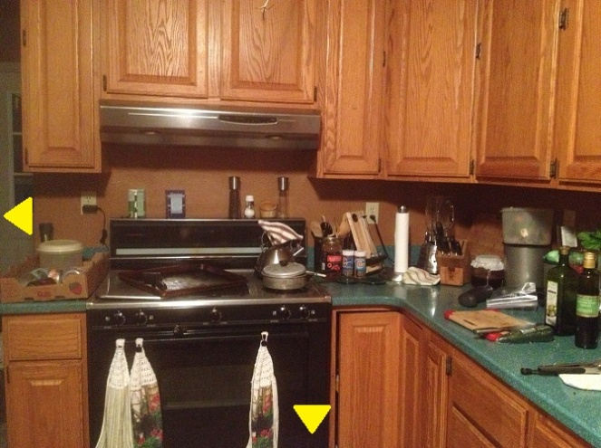
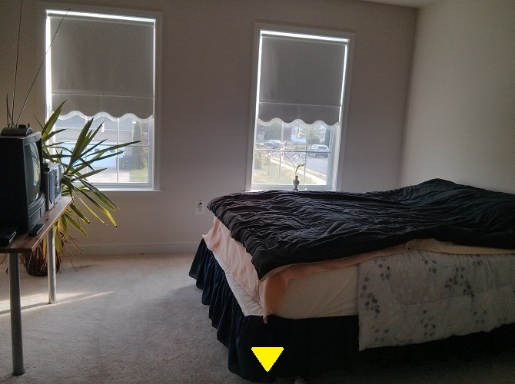
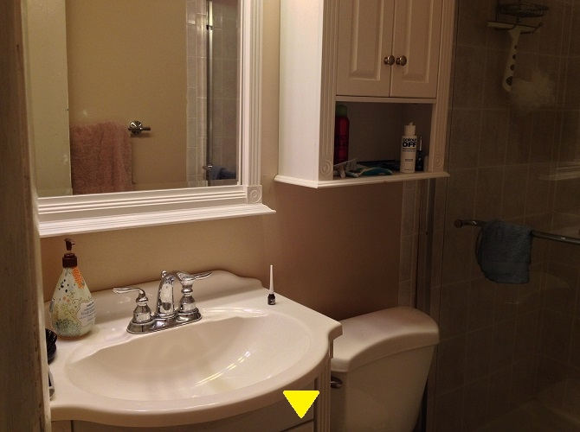
Scavenger Hunt
By the Pickpockets
Notes:
Kelsey introduce game

Slide 2

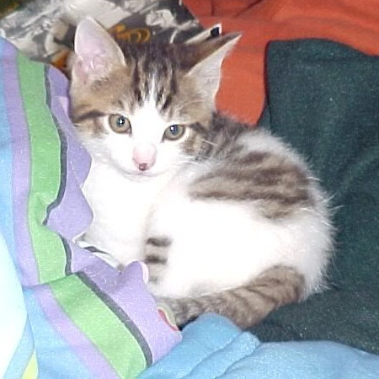
Kelsey Gardner
Project Manager; Asset Designer
• Came up and coded original prototype
• Photographer and main asset designer
• Contributed game and story details
• Set up GitHub and Blogspot
Notes:
Kelsey Introduction

Slide 3

Mohammad Salim
Assistant Programmer; Video Editor
• Modularized code
• Created Pause Menu
• Video editor
• Contributed game and story details
Notes:
Mohammad Introduction

Slide 4

Victor Callejas
Assistant Programmer
• Programmed beta version of subtitles and generated transition arrows
• Contributed game and story details
• Assisted with level transitioning layout
Notes:
Victor Introduction

Slide 5
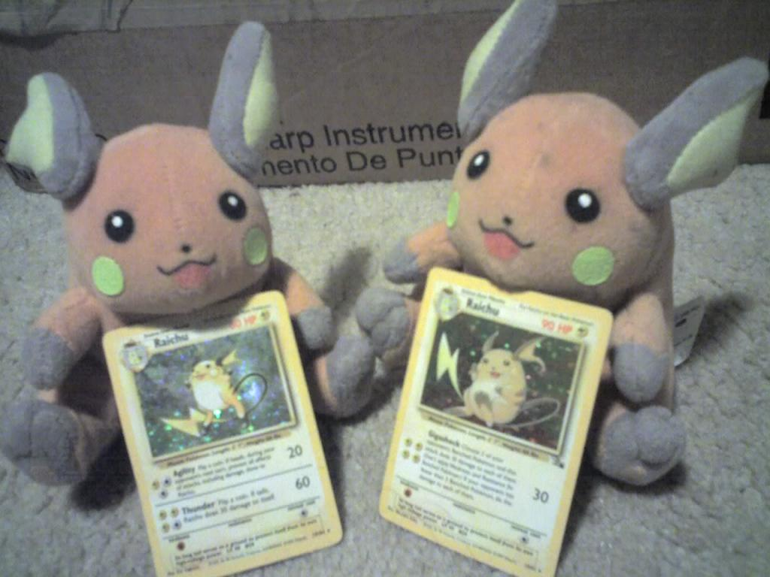
Tom Tran
Lead Programmer; Story Planner
• Created baseline story
• Programmed levels, puzzles, cutscenes, and main menu
• Contributed game and story ideas
• Supplied main setting of game
Notes:
Tom Introduction

Slide 6

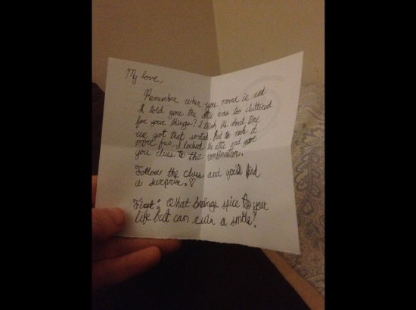
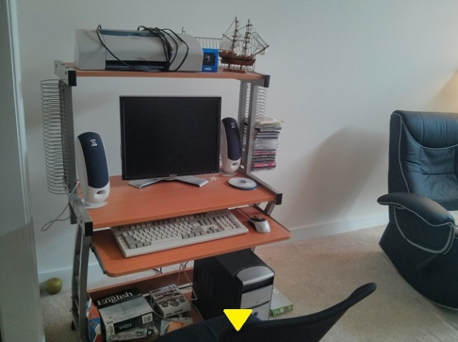

Game Overview
Psychological point and click
Features
Gather clues to progress through the story and learn more about Caroline and Michelle.
Notes:
Kelsey talk about gameplay and story

Slide 7
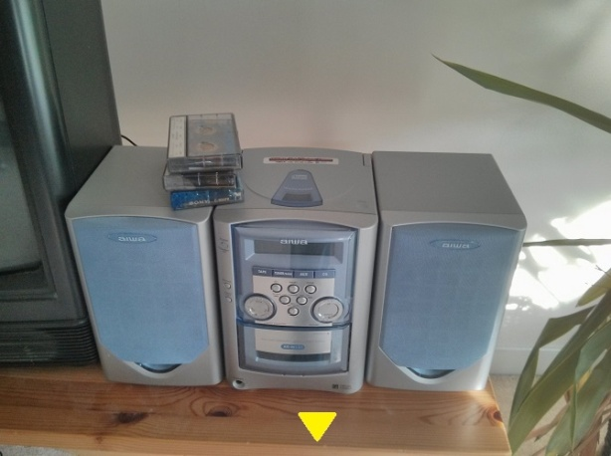
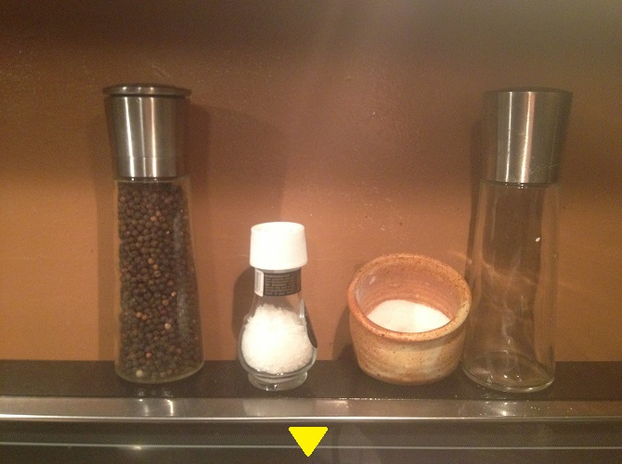
Improvements
Changes since Prototype
Improvements
Modularized code
Main menu
Pause menu
Csv level loading
Videos
Full story
-More rooms, puzzles, and cutscenes
Audio bugs
Skippable cutscenes
Much of the original prototype code and content were retained
Notes:
Tom talk about improvements over prototype

Slide 8
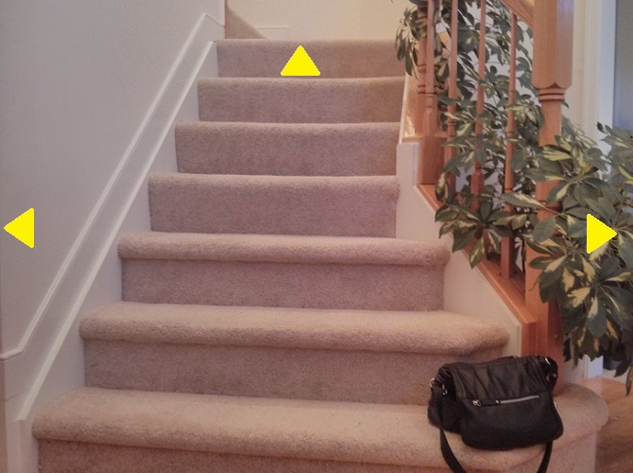
Obstacles
• Cell phone with our photo resources was stolen halfway through the project
• Difficult to coordinate with different schedules
Notes:
Victor talks about obstacles

Slide 9
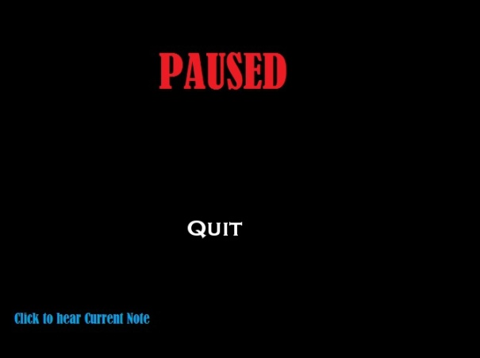


Things to Improve
Features Needed
Notes:
Mohammad talks about things we can improve on

Slide 10
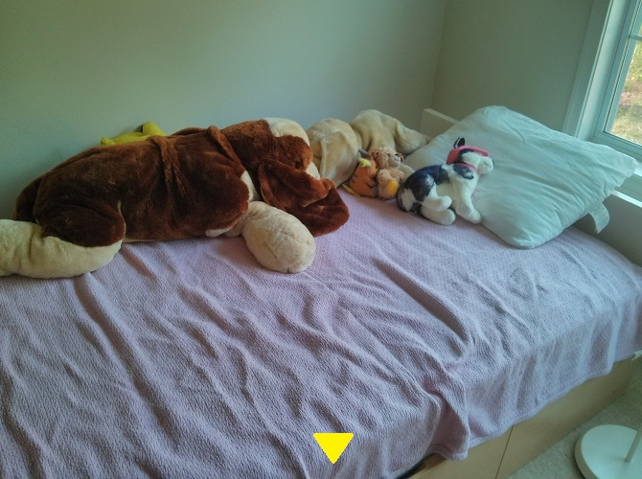
Questions??

